Slide 1

Contract Monthly Claim System
ST10448454 Afeziwe Thandani prog6212

Slide 2

Problem statement
At many universities, lecturers complete claims using manual forms.
This process is slow, confusing, and mistakes happen easily.
CMCS was created to make the claim process faster and easier.
The system helps lecturers, coordinators, and HR work in a simple and modern way.

Slide 3
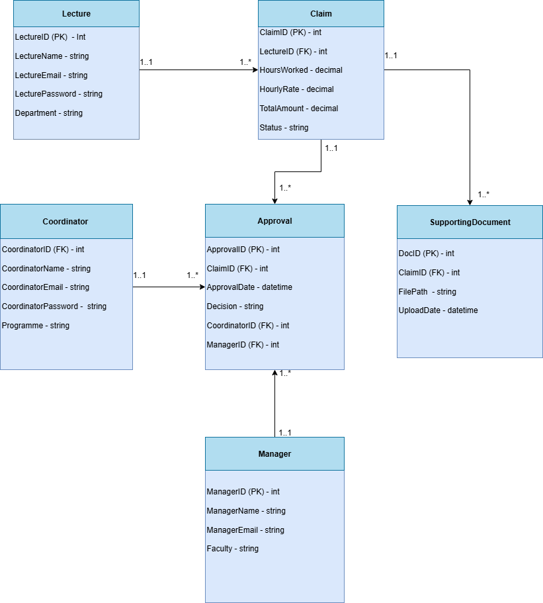
System architecture
Lecturer
Submits monthly claims.
Their claims are reviewed by the Coordinator.
Their final approved claims are processed by HR.
Coordinator
Receives claim submissions from Lecturers.
Reviews, checks, and approves/rejects claims.
Sends approved claims forward to HR.
HR
Manages all users (creates lecturers, coordinators, managers).
Views all submitted and approved claims.
Generates reports for payments.
Final step before payments are made.

Slide 4
Lecturer → Claim
One Lecturer can submit many Claims.
Coordinator → Claims
One Coordinator manages many Lecturers’ Claims.
HR → Users
HR can create and manage many Users (Lecturers, Coordinators, Managers).
HR → Claims
HR can view many Claims from the whole system.

Slide 5
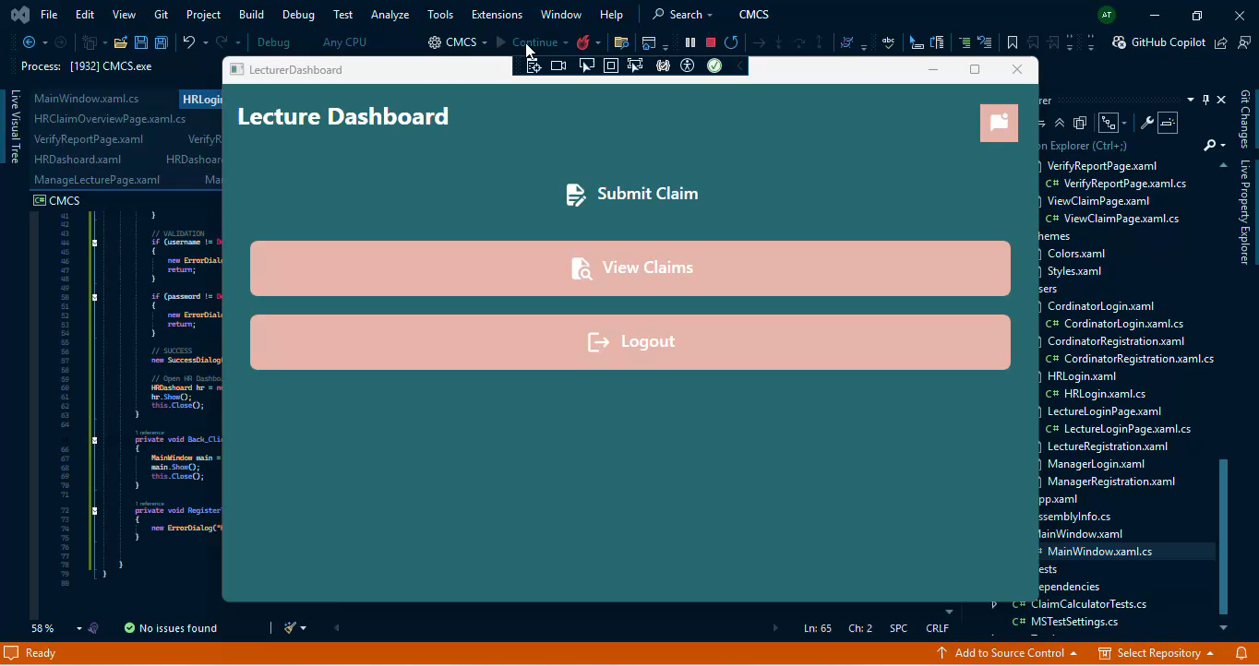
Lecturer workflow
What a Lecturer Can Do
Log into the system.
Fill in a claim form for the hours they worked.
Upload a document for proof.
The system automatically calculates the total amount using hours × rate.
The form checks for errors before submission (like missing fields or wrong numbers). Play the video to see

Slide 6
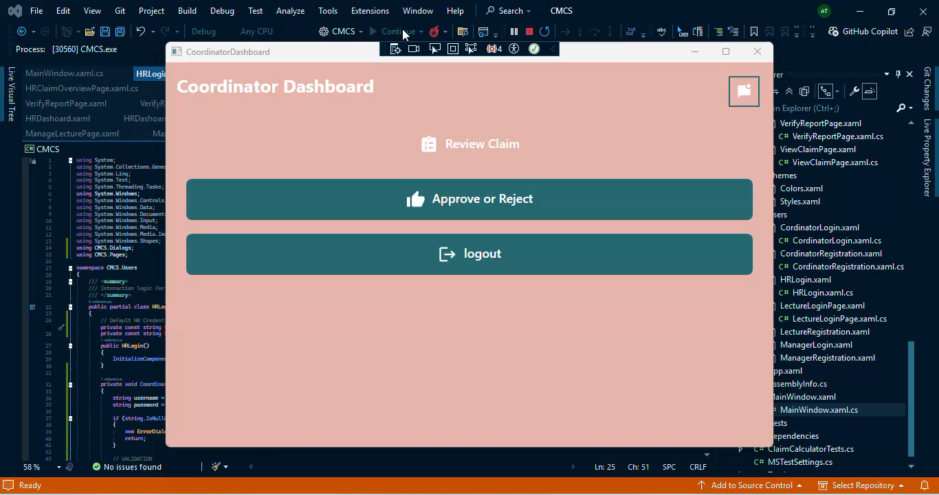
Coordinator Workflow
What the Coordinator Can Do
See all lecturer claims.
View the status (Pending, Approved, Rejected).
Approve or reject claims with one click.
The system helps them by showing:
Claim details
Total amount
Submission date
Play the video to see

Slide 7
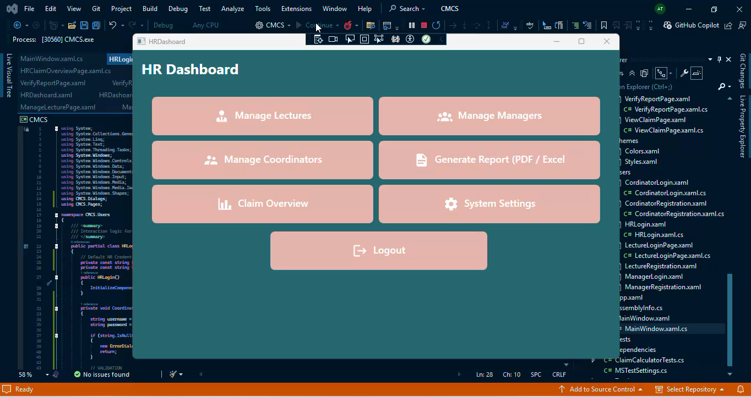
HR workflow
What HR Can Do
Manage lecturers (add, edit, delete).
Update hourly rates.
See all claims in one place.
Generate a PDF report for:
Total number of claims
Approved claims
Rejected claims
Claim totals
Play the video to see

Slide 8

Technical highlights
CMCS is built using C# and WPF.
Uses Entity Framework for the database.
Uses SQL Server to store all users and claims.
GitHub was used to manage versions and backup the project.

Slide 9
Benefits and value
The process becomes faster and more accurate.
01
Lecturers don’t do calculations manually.
02
Coordinators get a clean dashboard to approve claims.
03
HR gets automatic reports instead of doing them by hand.
04
The system reduces mistakes, paperwork, and stress.
05
CMCS makes the whole claim process simple, modern, and reliable
06

